Slide 1
3MTT FELLOW’S PROJECT BY
SHEHU USMAN PANDA
FE/23/16640854

Slide 2
TITLE
DATAD ANALYSIA AND VISUALIZATION OF CALIFORNIA HOUSING TRAIN

Slide 3
INTRODUCTION
Data storytelling is the concept of building a compelling narrative based on complex data and analytics that help tell your story and influence and inform a particular audience.
It is a build model of housing prices to predict median house values in California using the provided dataset. Train the model to learn from the data to predict the median housing price in any district, given all the other metrics. Predict housing prices based on median_income and plot the regression chart for it.

Slide 4
AIMS TO PRESENT A DATA STORY PASSING INFORMATION ON CALFORNIA HOUSNG TRAIN
OBJECTIVES
TO PRESENT A DATA STORY SHOWING THE RELASHINSHIP BETWEEN, POPULATION SIZE, HOUSING AGE, NUMBER OF ROOMS , IN A HOUSE, AND THE VALUE OF THE HOUSE.

Slide 5
METHODOLOGY
Google clab was used to import data from Pandas using phyton program language. The data was cleaned using the program as shown in the pictures below.

Slide 6
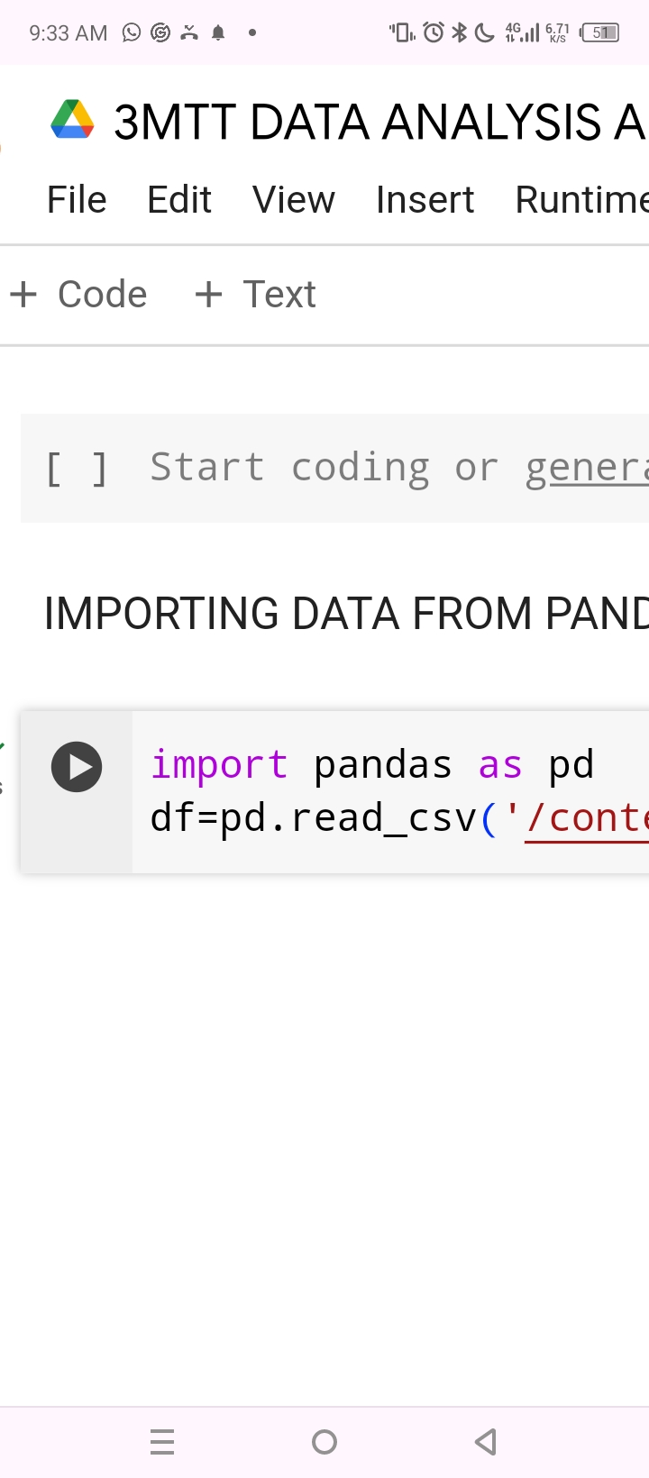

Slide 7
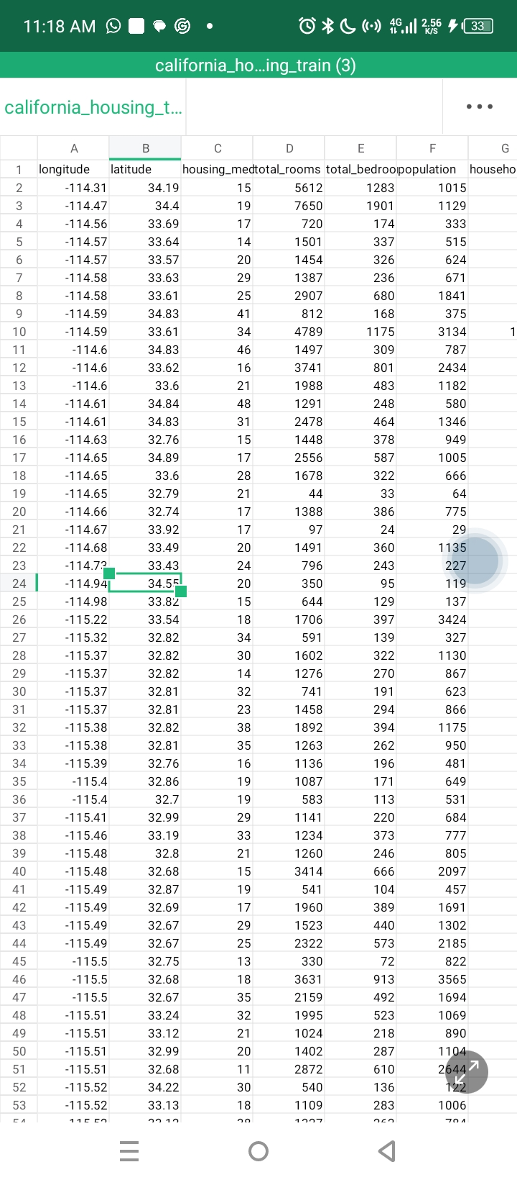
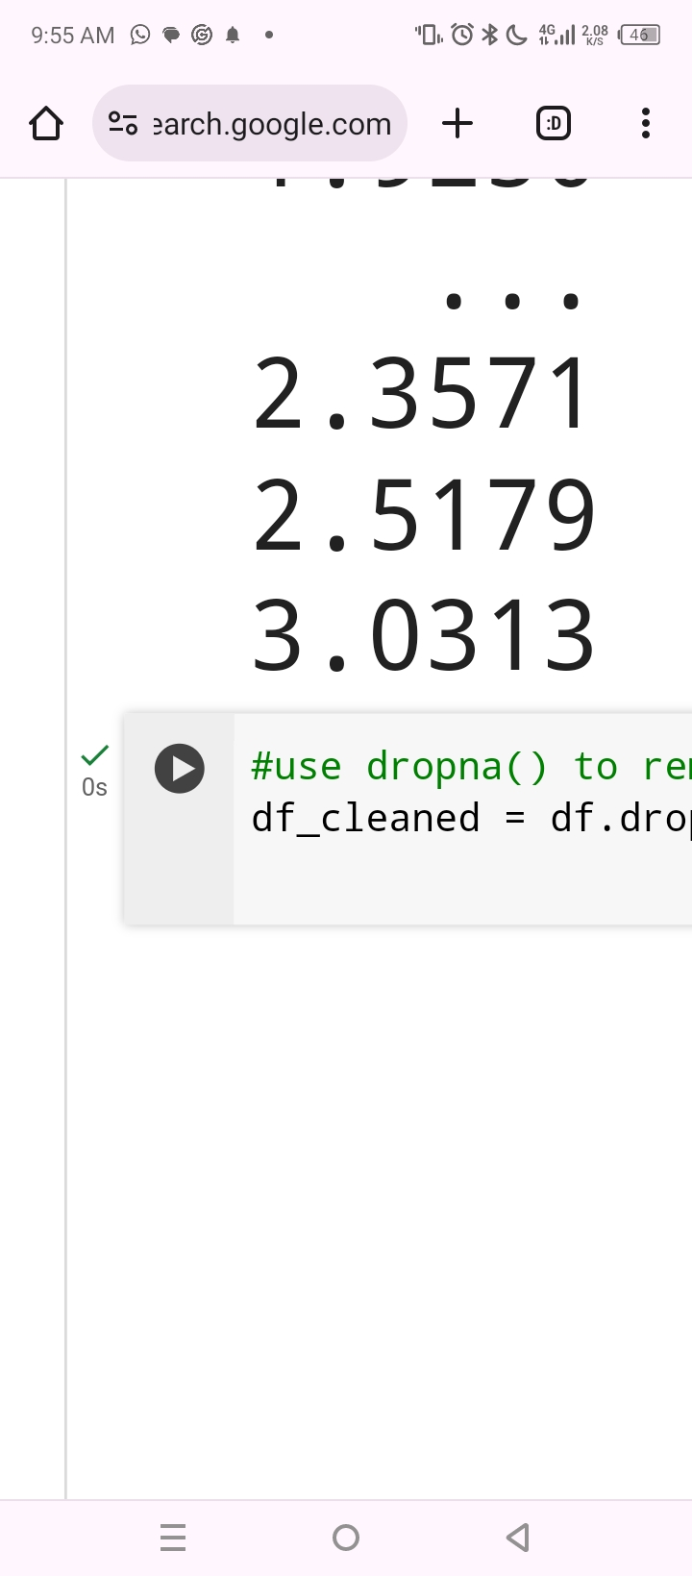

Slide 8
METHODOLOGY
Statistical analysis was done on the cleaned data. The mean age of housing, mean cost of house, mean income of house hold were calculated and presented as bar charts as shown below. Correlation coefficient was also calculated to find the relationship between the population of the community and the number of houses available as well as the number of rooms in the houses.

Slide 9
RESULTS
Below is the data story showing the results of the data analysis done on the data set.

Slide 11
Total population | 24302757
Total_rooms | 44942295
CORRILATION | 0.86017
Total population | 24302757
Total_rooms | 44942295
CORRILATION | 0.86017
Total population | 24302757
Total_rooms | 44942295
CORRILATION | 0.86017

Slide 13
total_bedrooms | 9169984
Total population | 24298470
CORRILATION | 0.691871

Slide 14
CONCUSSION
There is a ralationship between population size and number of rooms in their houses so also between household income and the cost of his house

Slide 15
RECOMMENDATION
Government to empersises on appropriate number of rooms for each population size per each house to avoid overcrowded shelter.

